Slide 1
Temperature Forecasting - Deep Learning Machine
By Mahshid Alinejad

Slide 2
Agenda
Introduction
Data Overview
Feature Engineering
Model Architecture
Hyperparameter Tuning
Model Evaluation
Results
Conclusion
Q&A

Slide 3
Introduction
Objective: Forecasting temperature for Vancouver using historical data.
Approach: Utilize LSTM (Long Short-Term Memory) neural networks for sequence prediction

Slide 4
Data Overview
Data Source: Found the data through Github
Time Period: 2012-10-01 - 2017-11-3 - predicts 7 days out
Cities Included: Vancouver
Data Columns: Date, Temperature in Celsius

Slide 5
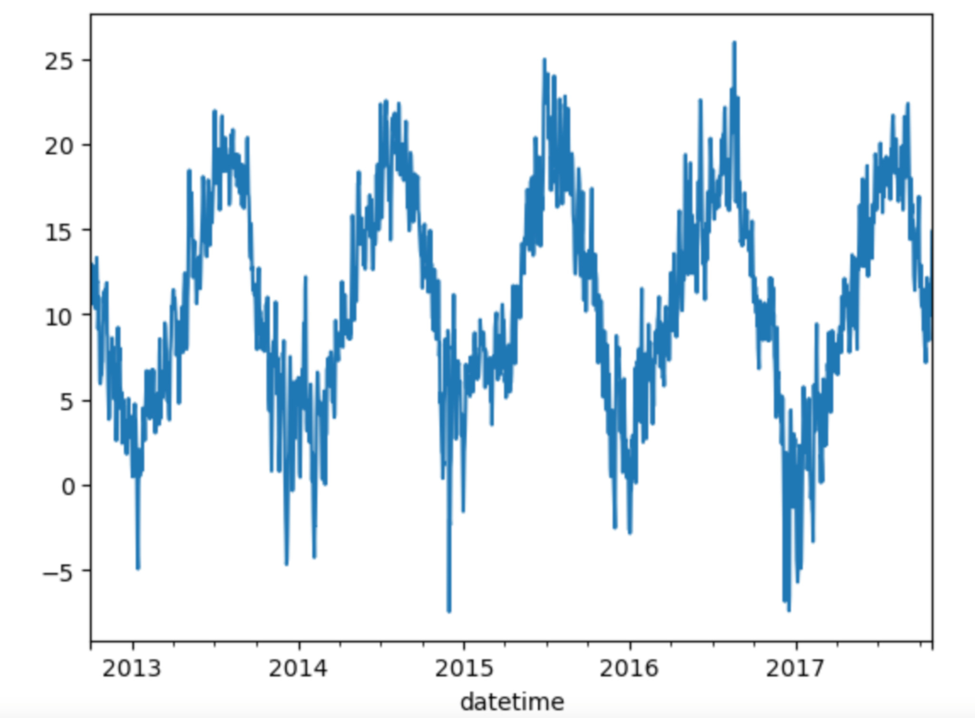
Data Description
The original data consists of hourly temperatures for Vancouver spanning 5 years, from 2012 to 2017. To predict the daily temperature for the next 7 days, I resampled the data to daily averages. I then split the dataset into training and testing sets, using an 80/20 split based on time: the first 4 years were used for training, and the last year was used for testing.

Slide 6
Data Cleaning and Preparation
The following steps were performed to clean and prepare the data:
Dropped all the cities except Vancouver from the dataset.
Dropped all rows with missing values (NANs).
Converted temperature values from Kelvin to Celsius using the formula:
Celsius = Kelvin − 273.15 Celsius=Kelvin−273.15

Slide 7
Feature Engineering
Feature engineering is the process of using domain knowledge to create features that make machine learning algorithms work. For this project, the feature engineering steps included:
Datetime Features: Extracting features like month, day of the week, and hour from the datetime column to capture seasonal and time-of-day patterns.
Rolling Statistics: Calculating rolling mean and rolling standard deviation to capture trends and volatility in the temperature data.

Slide 8
Model Description
I employed an LSTM model to predict the temperature for the following day using the previous 15 days' temperatures as input features. The model was trained on 4 years of data and achieved an R² score of 93%.
To forecast the temperature for the next 7 days, the model must be run recursively. This involves predicting the temperature for the next day, then appending the predicted value to the feature set and using it for the subsequent day's prediction. As the model progresses through the 7-day forecast, the quality of predictions deteriorates because each prediction relies on previous predictions rather than actual values. Consequently, this type of model is best suited for short-term forecasts, typically up to a few days ahead.

Slide 9
Model Training and Evaluation
Training Details:
Epochs: 50
Batch Size: 32
Validation Split: 20%
Evaluation Metrics:
Mean Absolute Error (MAE)
R² Score

Slide 10
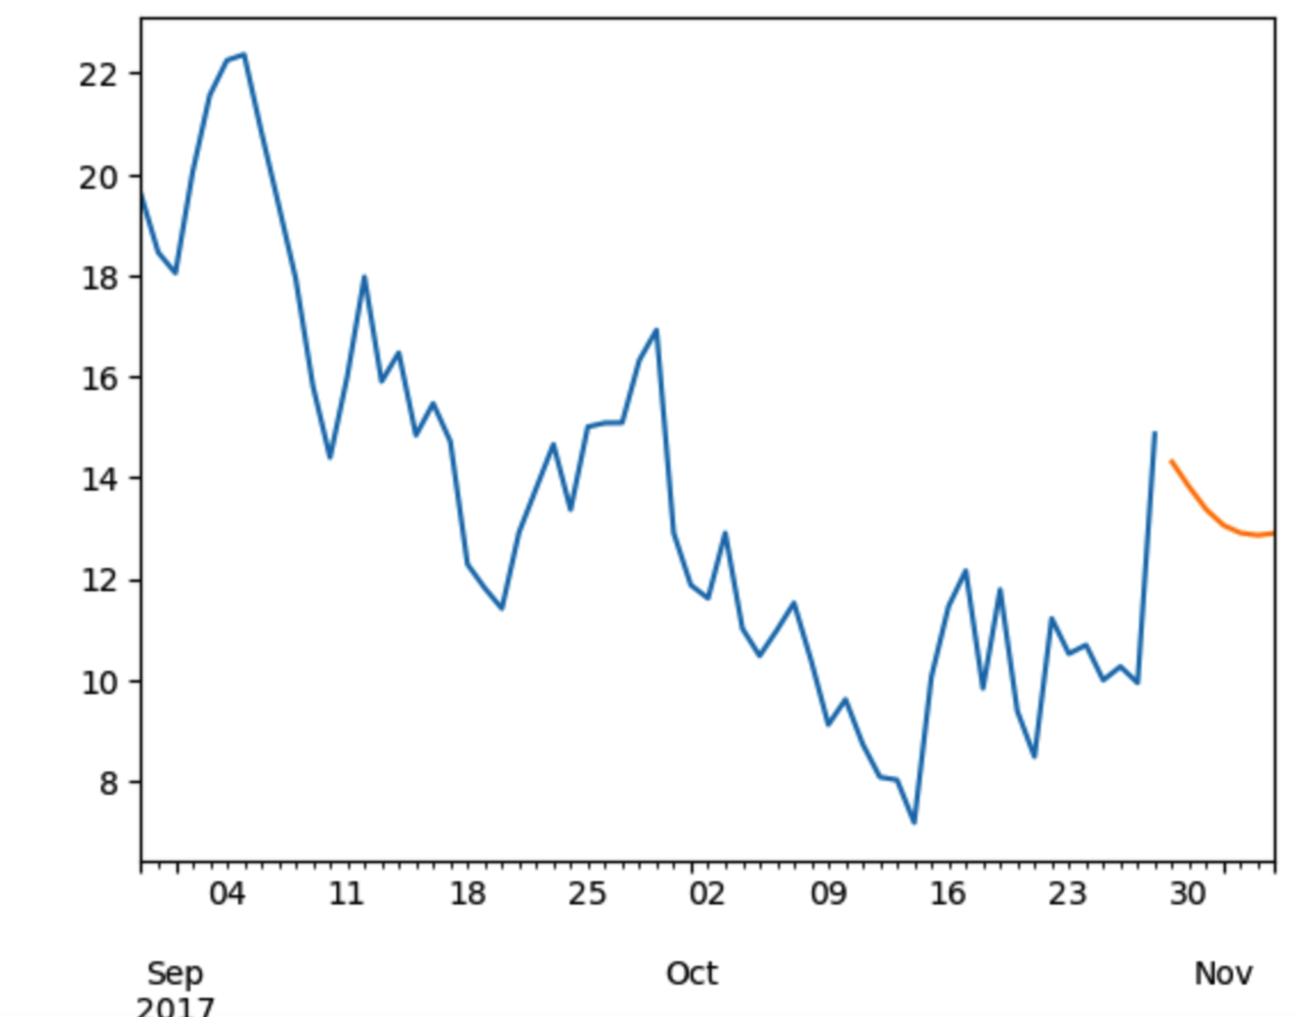
Results
Model Performance
The performance of the model was evaluated using Mean Absolute Error (MAE) and R² score. The metrics are as follows:
Train Mean Absolute Error (MAE): 1.181
Test Mean Absolute Error (MAE): 1.324
Test R² Score: 0.940

Slide 11
Conclusion
Summary:
Model Performance: An LSTM model is built and optimized using Keras Tuner. The model consists of multiple LSTM layers with dropout for regularization and a final dense layer for the temperature prediction.
The Mean Absolute Error is low, and the R^2 score is high, suggesting that the model captures the underlying patterns in the temperature data effectively.

Slide 12
Next Steps
Improvement of Preprocessing: Improve the preprocessing steps to handle any potential outliers and more effectively normalize the data.
Expand Data Coverage: Incorporate additional weather features such as humidity, wind speed, and atmospheric pressure to potentially improve the model’s performance.
Longer Forecasting Horizon: Explore models capable of longer-term forecasting and evaluate their performance.
Model Ensemble: Combine predictions from multiple models to potentially improve accuracy and robustness.
User Feedback Integration: Integrate a mechanism to gather user feedback on predictions to continuously improve the model.

Slide 13
Q&A
Questions?
Thank You!

